Slide 1
Energy of Wind in Germany and Poland
Felipe Gastaldi, Changhong Guan, Andrew McAlister, Swathi Mohandas Naik, Kerri Robinson

Slide 2

Overview
Problem: Analyzing historical alternative energy trends with the most advanced European countries, how can we project future alternative energy adoption for less sophisticated European nations, and how key energy companies might financially benefit from their adoption?
Hypothesis: Our hypothesis is the wind turbine market sector will experience accelerated exponential growth in the next few years. We will provide revenue growth predictions for two companies – Vestas and Gamesa. We have also filtered the stock data to focus specifically on those companies.
Approach: We tried 4 different models for comparison: Linear Regression, Time Series, Gompertz and Logistic Regression. Our comparison is in a few slides.

Slide 3
Data
Topics
Energy related (electricity production/consumption, wind energy and weather conditions)
Historical stock data for the companies under consideration (VESTAS and SIEMENS GAMESA) and their key performance indicators from the financial reports.
Capacity of wind production Germany and Poland can maintain.
Cleaning
Variables
Datasets
Wind turbine market share from Statista
Energy data from Our World in Data on GitHub
Vestas and Gamesa Financial Reports from respective websites
Vestas and Gamesa Stock Prices from Finance.Yahoo
Company revenue
Historical wind energy adoption rates
Projected growth rate population size
Historical energy consumpiton
Price of oil
Time of peace/war
Estimate of maximum wind energy production
Historical company performance
Country GDP
Year
Spent a considerable amount of time for monthly wind energy with historical data for Germany and Poland
Faced hurdles with stock and financial datasets not being synchronized
Searching for Key KPIs was tedious to dig into each annual report for the two companies

Slide 4
Determining Onshore Wind Capacity Limits
Focused on determining maximum realistic wind energy capacity for our target countries
Wind energy capacity can be simplified down to available land.
Limited approach to onshore wind capacity only.
Based on a study “Potenzial der Windenergienutzung an Land” (2011) by the German Wind Energy Association (BWE) and further analyzed by Beckius and Magnusson (2013) it has been estimated that a realistic target for the total wind energy output of Germany would utilize a footprint equivalent to about 2% of German land area or a 189 GW capacity.
In a study by Ember Coal to Clean (Czyzak 2022) they determined that Poland currently can use only 0.3% of their total land for wind turbines due to current policies around turbine distancing. They estimated this capped their max capacity at 10 GW.
For the purposes of our analysis, we will assume that Poland will adopt a similar policy to other European countries and can reach a similar 2% target we set for Germany which is roughly 67 GW.
Notes:
When creating future wind energy projections for our target countries it is critical that we consider the maximum amount of wind energy each country can produce
Wind energy this can be simplified down to available land. For the purposes of this analysis, we will limit our scope to onshore wind and ignore offshore wind capacity limits.
Based on a study “Potenzial der Windenergienutzung an Land” (2011) by the German Wind Energy Association (BWE) and further analyzed by Beckius and Magnusson (2013) it has been estimated that a realistic target for the total wind energy output of Germany would utilize a footprint equivalent to about 2% of German land area.
The 2% target equates to an estimated 189 GW capacity potential. While this capacity target may end up smaller than reality due to advancements in turbine technology or other factors, for the purposes of this project we will set the 189 GW capacity estimate as our cap for future energy potential.
In a study by Ember Coal to Clean (Czyzak 2022) they determined that Poland currently can use only 0.3% of their total land for wind turbines due to current policies around turbine distancing. They estimated this capped their max capacity at 10 GW.
Since the 0.3% cap is largely due to legal frameworks and not technical or landscape constraints for the purposes of our analysis we will assume that Poland will adopt a similar policy to other European countries and can reach a similar 2% target we set for Germany. If we extrapolate from the 10GW estimate for .3% land use for Poland a 2% land use would place Poland total capacity target at ~67 GW.

Slide 5
Analyzing Financial Performance
Focused on financial performance of 2 major wind turbine providers – Vestas and Gamesa (Siemens)
Reviewed annual reports of each company going back to 2016 (earliest available)
Needed to determine several market factors
Market presence of each company
Market landscape in our target countries
Pace and direction of progress in wind energy capacity for our companies and countries
Core questions were surfaced
What % of each company's business is tied to each country?
What % of each country’s market is tied to each business?

Slide 6
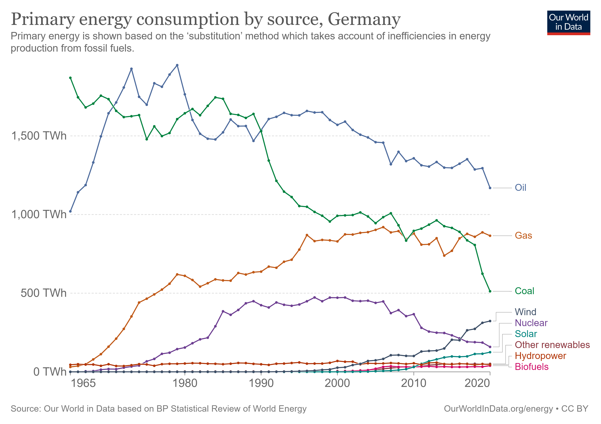
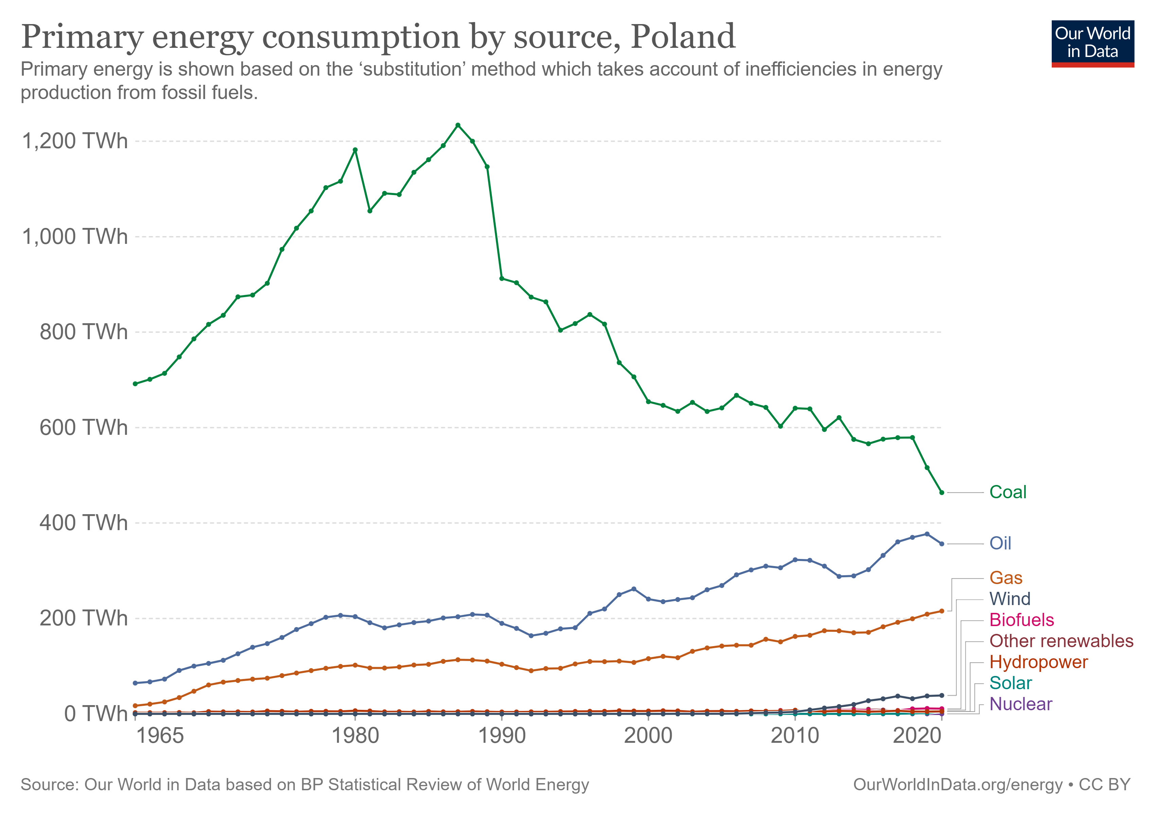
Data Exploration
Wind has become #1 renewable energy source for electricity generation in both Germany and Poland
Notes:
From our world in data org data, we found wind energy has become the #1 renewable energy source for electricity generation in both Germany and Poland, in recent years. While those two countries are high on the list of dependance on Russian fossil fuel, we have assumption that wind energy section in both countries will experience high growth.

Slide 7
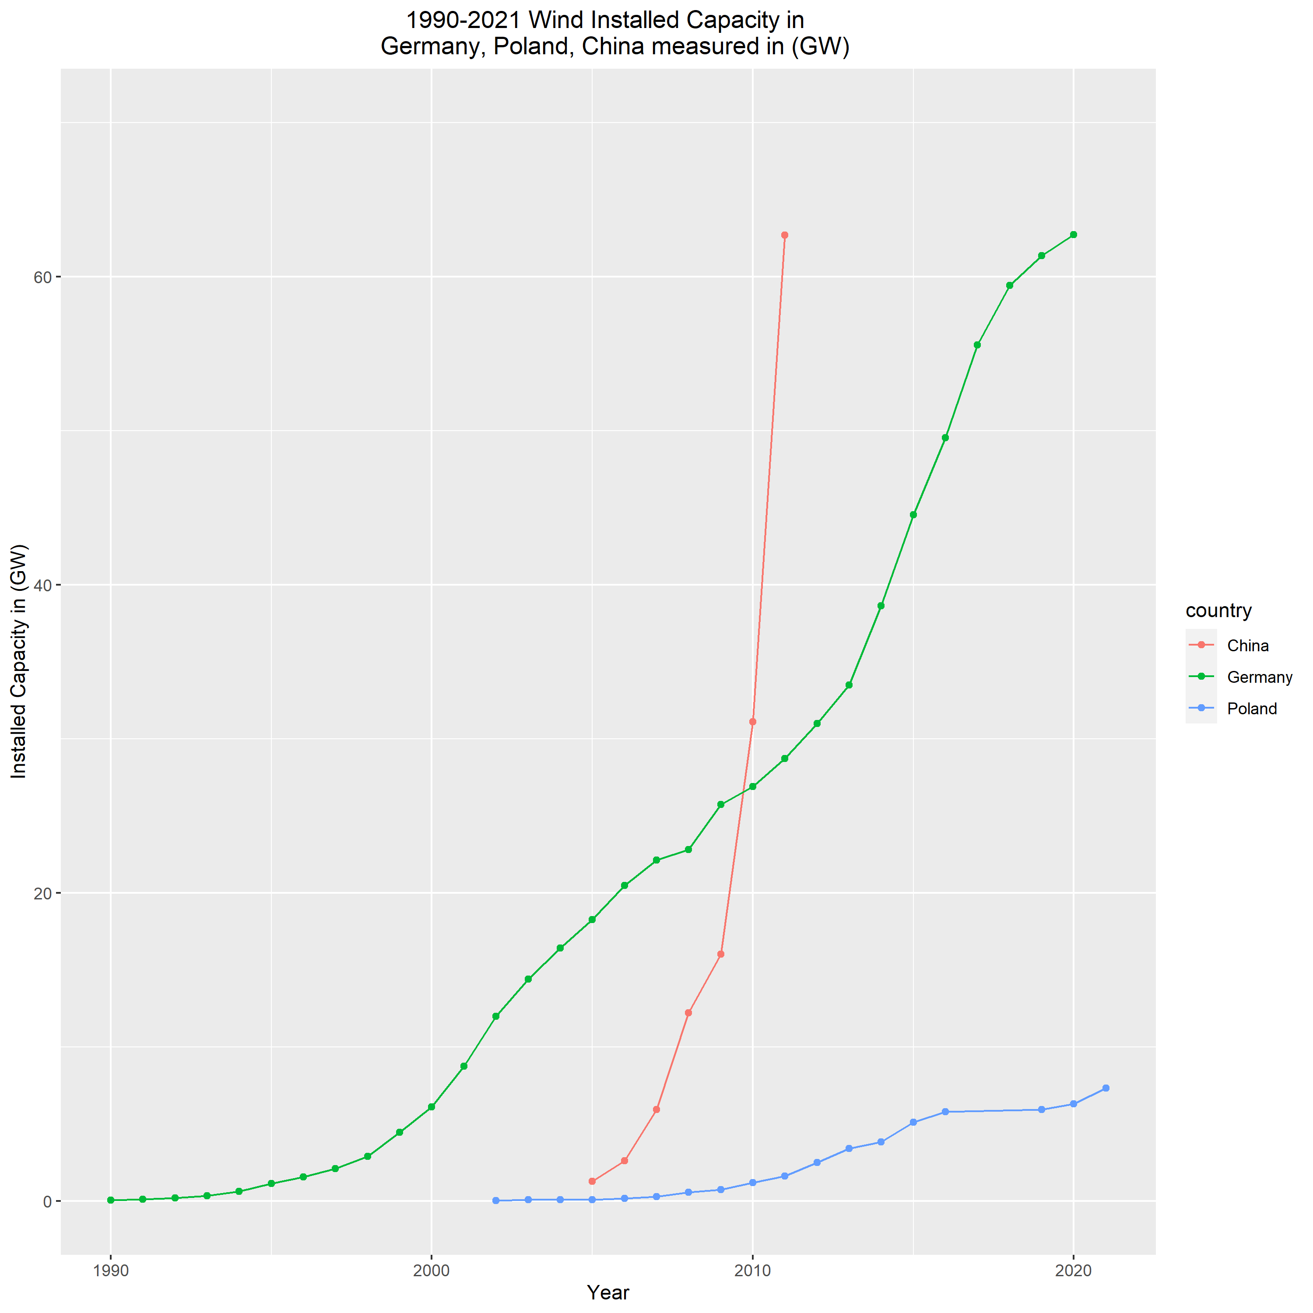
Zoom-in on Wind Installed Capacity
Installed capacity for wind in Germany has experience parabolic growth since 1990
Poland lagged Germany on wind installation for about 12 years
Poland wind adoption rate seems slower than Germany
Notes:
I also put in China wind install capacity in the graph, to show what an exponential growth could look like compared to parabolic growth. Graph was cut off above 75 GW

Slide 8
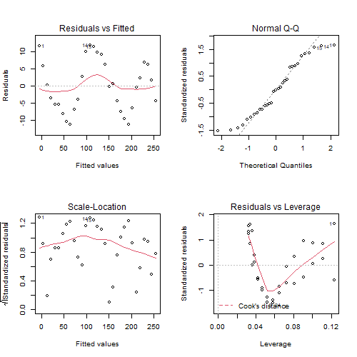
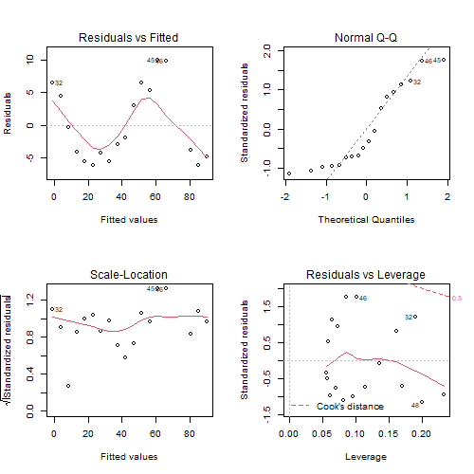
1st Model: Simple Linear Regression (SLR)
Procedure
Lm(installed_capacity~year)
BoxCox transformation to find optimal lambda
Germany is 0.5
Poland is 0.38, round up to 0.5
Both could use square root transformation
Lm(sqrt(installed_capacity)~year)
Assumption analysis
Germany SLR-boxcox Poland SLR-boxcox
Notes:
Standard SLR procedure, both applied 0.5 boxcox transformation, both have S shape system error, and parabolic growth does not have capping effect.

Slide 9


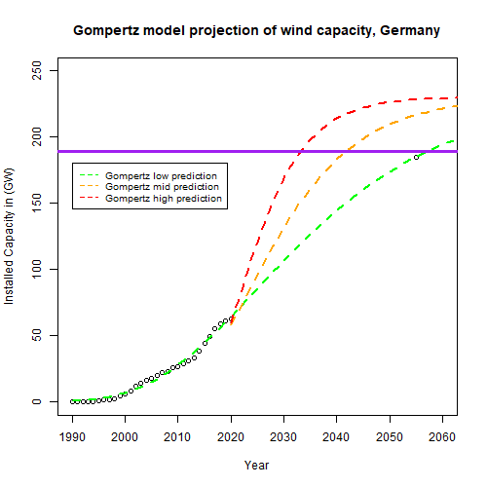
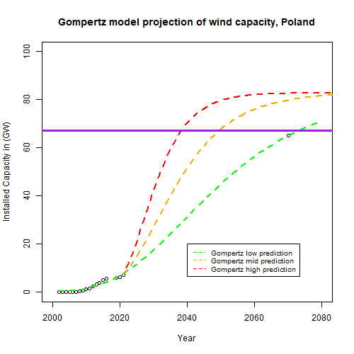
2nd Model: Gompertz
Gompertz is a time-series growth model
Procedure
Set cap point in distant future (due to lack of data)
nlsfit(model =10) has "singular gradient" error
Use nls(X2 ~ SSgompertz(X1, Asym, xmid, scal)) instead
Adjust scale to accommodate different growth rates
Modified Gompertz model
no longer capped without giving
enough future data
Original Gompertz Modified Gompertz
Notes:
Gompertz is most used to describe the growth of animals and plants, as well as the number or volume of bacteria and cancer cells. In our case, we do not have data for the fully cycle of growth, we could only insert hypothetical future steady state number aka cap number for both countries at an estimated future time Germany is 2055, Poland is 2070. without enough data at the end of the cycle, model tends to go over capping value.

Slide 10

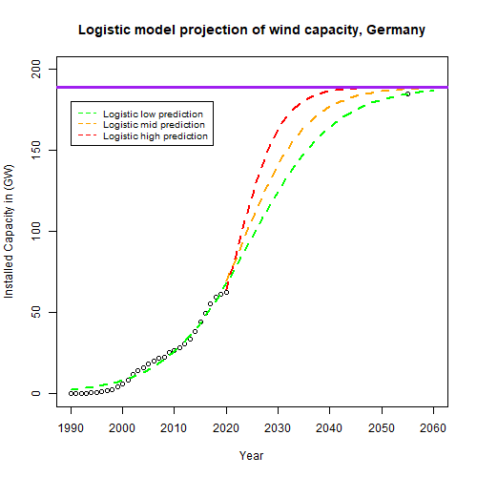
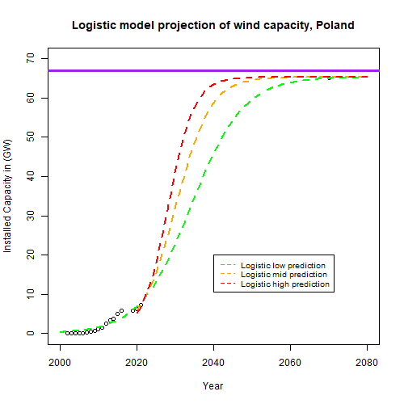
3rd Model: Logistic Model
Logistic model can also be used for time series data
Procedure
Set cap point in distant future (due to lack of data)
nls(installed_cap_MW ~ SSlogis(year, Asym, xmid, scal))
Adjust scale to accommodate different growth rates
Fit original data, and capped at countries' limit
Notes:
Again set future data,

Slide 11
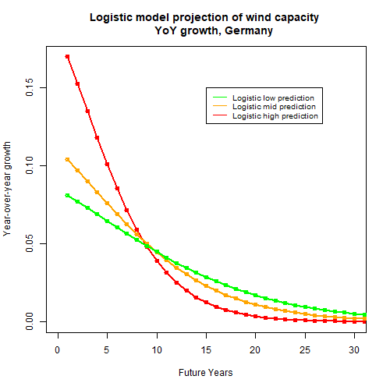
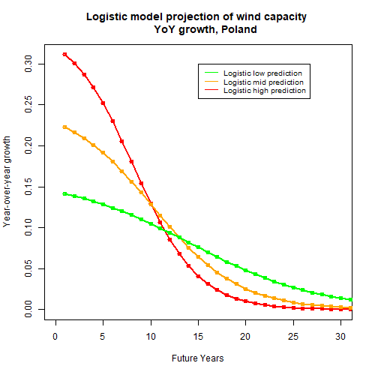
Wind capacity YoY growth
Germany will experience moderate growth in next 7 years
Poland will experience 10%+ growth in next 10 years
Notes:
Convert total installed capacity to percentage of year-over-year growth,

Slide 12
Wind Turbine Business Impact
Define:
Rev is company's revenue,
ap% is percentage a certain area's revenue divided by total Rev,
TP is total Poland wind market of a year,
TG is total Germany wind market of a year,
ms% is market share of company in a certain area
Base model: Rev X ap% = TP (or TG) X ms%
Growth model: Rev(1+g%) *ap%(1+g_ap%) = T *ms%(1+g_ms%)
Assume ms% is fixed
Meaning: Business growth in a certain market need to outpace area business percentage within the company.
Example: 2020-2021, Vesta's Poland business percentage within company grew 87.5%, from 2.4% to 4.5%, but Poland market growth rate is only 30%, if Vesta's market share in Poland has always been 50%, Vesta's revenue shrinks 30% (1300/1875). (note: small numbers might generate large % swings)
Notes:
Finally tie year-over-year growth in each country, to companies that do business in wind market sector.

Slide 13
Challenges
Limited historical data for wind energy production and consumption
Time series data meant we were limited in our available modeling techniques – initially attempted with SLR and time series but the assumptions did not hold
Original models were showing uncapped, exponential growth
Shift from projecting Stock Price to Revenue
Different performance reporting methods - MW delivered vs total MW capacity
Land constraints in Poland

Slide 14
Project Expansion Opportunities
Apply findings to other emerging markets
Analyze additional renewable sources of energy – solar, hydro, geothermal, etc.
Exploring optimal energy source mix
Macroeconomic considerations – recessions, pandemics, international conflicts, etc.

Slide 15
Conclusion
For our initial model, assumptions did not hold
Lead to testing different models and landed on Logistic Regression
Poland will outgrow Germany in Wind year-over-year growth in the future

Slide 16
Works Cited
Beckius, D., & Magnusson, D. (2013). The German wind energy market and its developers – a study of sourcing models, success factors and challenges. http://www.diva-portal.org/smash/get/diva2:644677/FULLTEXT01.pdf
Umwelt Bundes Amt (UBA) (2013), Potenzial der Windenergie an Land. https://www.wind-energie.de/fileadmin/redaktion/dokumente/publikationen-oeffentlich/themen/01-mensch-und-umwelt/03-naturschutz/bwe_potenzialstudie_kurzfassung_2012-03.pdf
Czyzak, P. (2022). Change is in the Wind. https://ember-climate.org/app/uploads/2022/03/Briefing_-Unlocking-onshore-wind-in-Poland.pdf
Rafael Lahoz-Beltra, Gompertz Function with R. https://encyclopedia.pub/entry/626

